Slide 1
DESIGN & DEVELOPMENT OF DATA ACQUISITION SYSTEM FOR ACOUSTIC STRUCTURAL HEALTH MONITORING OF WOODEN COMPONENTS
PRESENTED BY – VATANJEET SINGH

Slide 2
INTRODUCTION : URBAN FORESTS
In modern times, urbanization portrays a massively increasing trend. Reports from the Department of Economics and Social Affairs of the United Nations (UN DESA) shows that 54% of the world's total population lives in urban areas. By the end of the year 2050, it will be 64% and 86% for developing and developed nations, respectively. [1]
To maintain a healthy lifestyle in urban areas and check pollution, governments worldwide are working on an "urban forest" initiative. [2]

Slide 3

INTRODUCTION : URBAN FORESTS

Slide 4
INTRODUCTION : URBAN FORESTS
The mechanical stability of trees in these urban forests is an essential characteristic, and it is required to be known.
In these regions, the problem is exacerbated when there is an additional mechanical strain on trees due to construction work or underground utility lines.

Slide 5
INTRODUCTION : Non Destructive Testing (NDT)
Non-destructive testing (NDT) is a technique used to test and analyze a structure for discontinuities within its structure without causing damage to it. NDT also known as non-destructive examination/ evaluation (NDE), non-destructive inspection (NDT).

Slide 6
INTRODUCTION : Non Destructive Testing (NDT)
Evaluation of visual characteristic
Physical test
Chemical test
Mechanical test

Slide 7
INTRODUCTION : Non Destructive Testing (NDT)
Evaluation of visual characteristic
Physical test - ACOUSTIC TECHNIQUES
Chemical test
Mechanical test

Slide 8
ACOUSTIC SOURCE MECHANISM
External stimuli, such as the impact of an external body on the structure under investigation
Plastic deformation
Corrosion
Micro crack formation and growth
Crack free rubbing
Phase transformation
Cavitation

Slide 9
ACOUSTIC SOURCE MECHANISM
External stimuli, such as the impact of an external body on the structure under investigation
Plastic deformation
Corrosion
Micro crack formation and growth
Crack free rubbing
Phase transformation
Cavitation

Slide 10
LITERATURE REVIEW
The first clear documentation on acoustic waves inside wood was presented in 1964. This study shows that when the wood is stressed, it releases a small burst of energy that originates at micro and macro fractures, propagating through the wood as elastic waves [3]
DeBaise conducted an early study of AE monitoring in wood in 1966 in which cumulative AE event records for a variety of loading configurations on western white pine was presented. The study concluded that AE activity starts at very early stages of loading, between 5% and 20% of peak stress.[4]

Slide 11
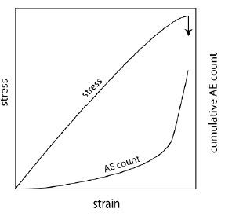
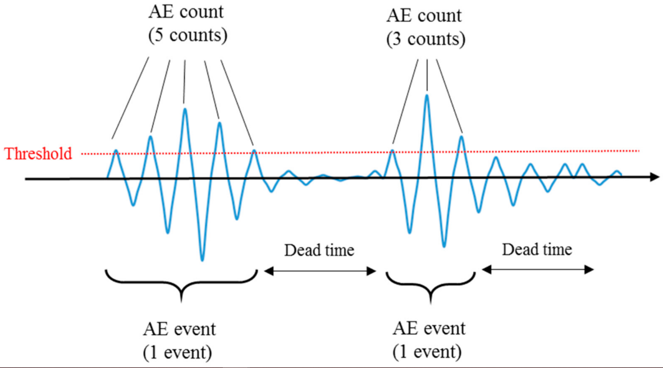
LITERATURE REVIEW
3
4

Slide 12
LITERATURE REVIEW
Ross et al.; in 1988 used acoustic waves to find mechanical properties for a wide range of woods. They obtained a correlative relationship between the mechanical properties of wood and the acoustic parameters in their study. [5]
Lemaster, in 1993 conducted a study in which AE was being used to characterize the flakes and individual particles used to make engineered wood panels. The recorded waveforms were analyzed in both the frequency and time domain. [6]
Bucur in 1996 in his study used the three techniques, i.e. vibratory, acoustic, and ultrasound techniques, to obtain material constants separately and compare their results. [7]

Slide 13
LITERATURE REVIEW
Pierre, in 2000 found out that AE shows a great potential to measure and monitor the tensile damage. The difficulty of typical ultrasonic techniques to detect tensile damage in wood was the main reason Pierre studied in this direction. [8]
Ritschel et al. in 2011 conducted a study on the tensile testing of Laminated Veneer Lumber (LVL) and monitored plywood samples using acoustic emission and digital image correlation.[9]
Other then AE, Resistance drilling has also been a mainstay health monitoring technique for assessing the structural integrity of standing trees. In their analysis, Gao et al. conclude resistance drilling to be among the most efficient and reliable processes [10]

Slide 14
LITERATURE REVIEW
The quality of standing trees in forests can also be evaluated using acoustic non-destructive methods involving impact stress waves. In their work on western hemlock and Sitka spruce, Wang et al. have applied this technique for evaluating wood strength and stiffness in standing trees [11].

Slide 15
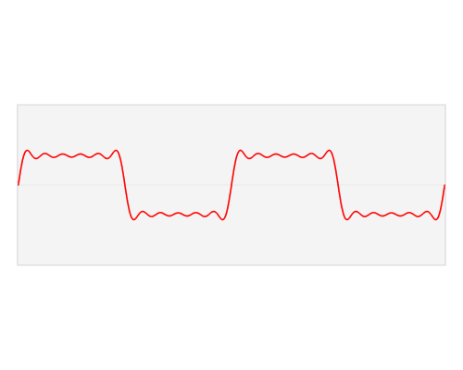
FOURIER TRANSFORM

Slide 16
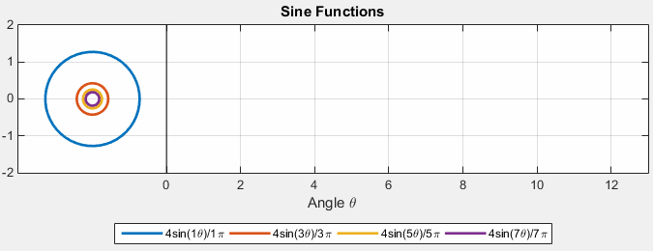
FOURIER SERIES

Slide 17
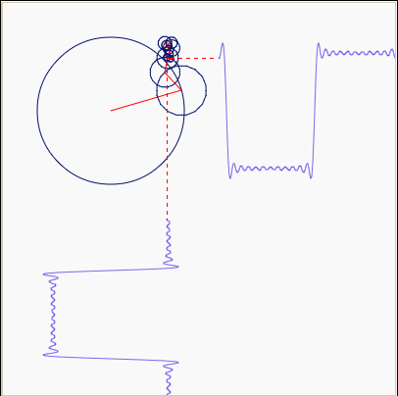
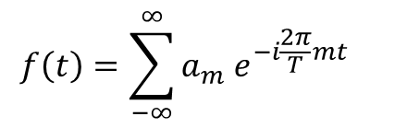
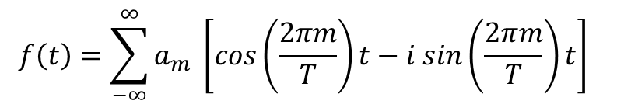
FOURIER SERIES

Slide 18
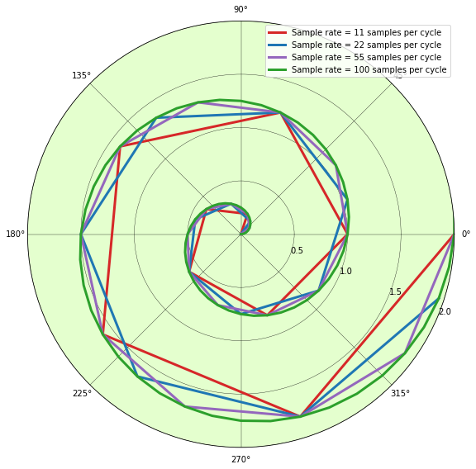
NUMBER OF SAMPLES

Slide 19
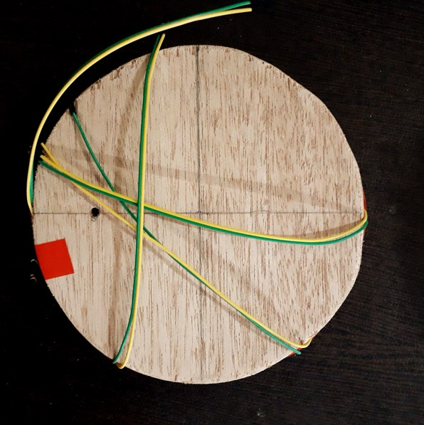


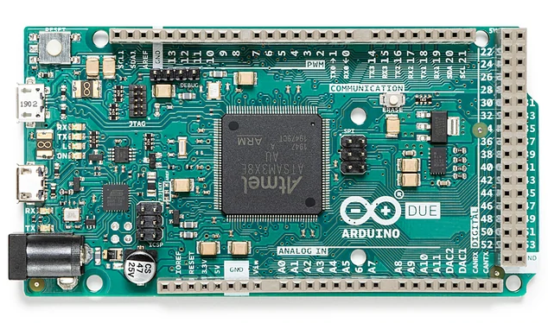

EXPERIMENTAL SETUP

Slide 20
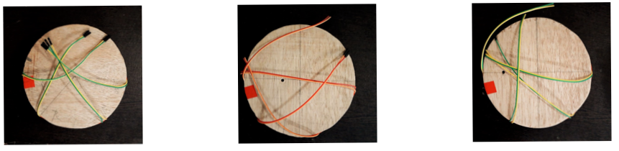
3 TYPES OF WOODEN BLOCK

Slide 21
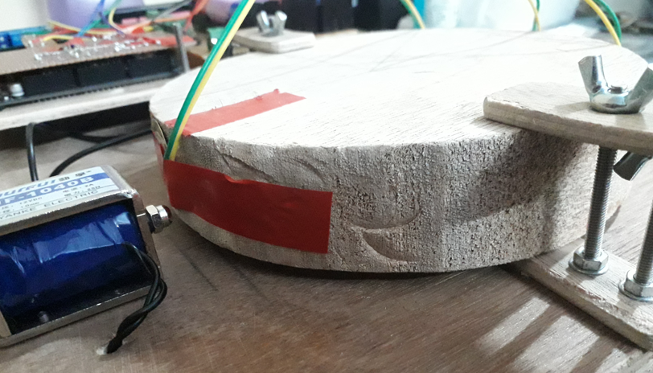
HOLDINNG OF THE WOODEN BLOCK

Slide 22
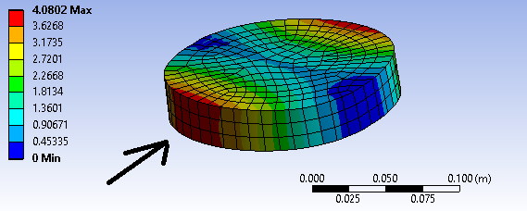
PLACEMENT OF SENSOR ON THE WOODEN BLOCK

Slide 23
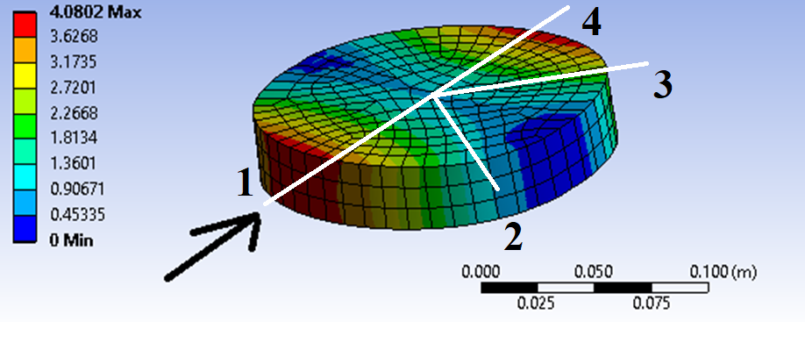
PLACEMENT OF SENSOR ON THE WOODEN BLOCK

Slide 24
PLACEMENT OF SENSOR ON THE WOODEN BLOCK

Slide 25
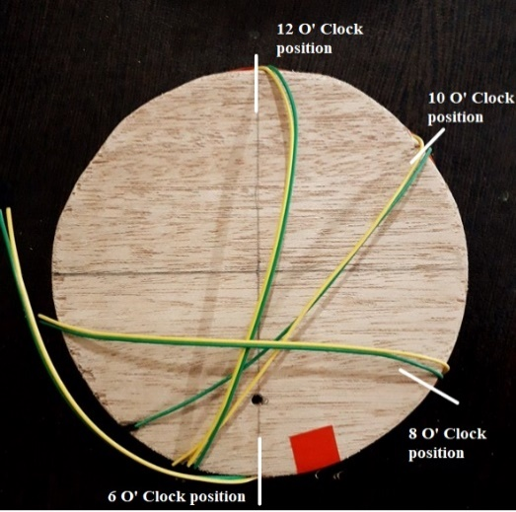
PLACEMENT OF SENSOR ON THE WOODEN BLOCK

Slide 26
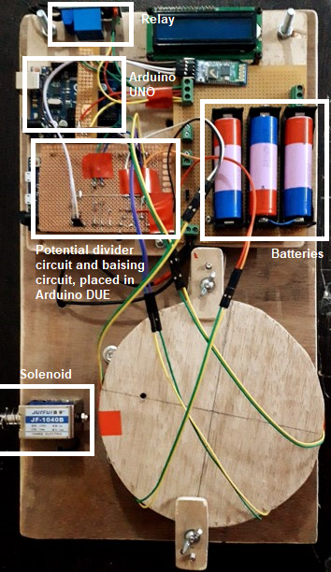
COMPLETE SETUP

Slide 27
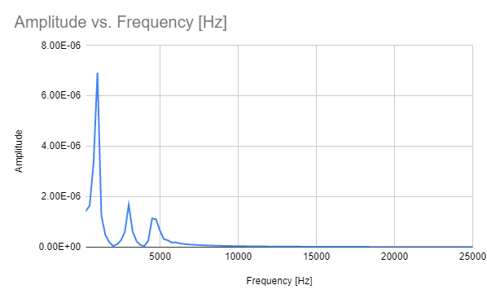
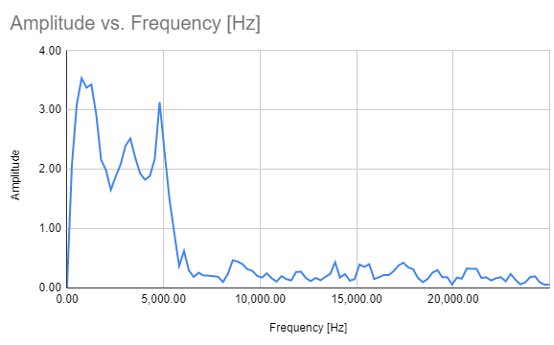
SIMULATED RESULTS COMPARED TO SETUP RESULTS

Slide 28
SIMULATED RESULTS COMPARED TO SETUP RESULTS
1010.10 Hz
1000 Hz
4797.98 Hz
3282.83 Hz
3000 Hz
4750 Hz

Slide 29

EXPERIMENTATION

Slide 30
THANKYOU

Slide 31
REFERENCES
[1] Lüttge U., Buckeridge M., Trees: structure and function and the challenges of
urbanization. Trees (2020).
[2] Team, D. (2021, September 20). 5 Steps to Urban Forest Management Plan Success.
Dudek. https://dudek.com/urban-forest-management-plan-steps-to-success/
[3] Robert J. Ross, "Non-destructive Evaluation of Wood", 2nd edition, United States
Forest Department, July 2015, pp-2.
[4] DeBaise GR, Porter AW, Pentoney RE (1966) Morphology and Mechanics of Wood
Fracture. Materials Res. Stds. 6(10):493-499.

Slide 32
REFERENCES
[5]Ross, R.J.; Pellerin, R.F. 1988. NDE of wood-based composites with longitudinal
stress waves. Forest Products Journal 38(5): 39–45.
[6] Lemaster, R.L. 1993. Particle and flake classification using acoustic emission, 9th
Symposium Nondestructive Testing of Wood. Madison, WI. 13–22.
[7] Bucur, V. 1996. Acoustics of wood as a tool for non-destructive testing, 10th
Symposium Nondestructive Testing of Wood. Lausanne, Switzerland. 53–59.
[8]Pierre, M. 2000. The contribution of NDT tools to assessment of mechanical damage
in wood, 12th Symposium Nondestructive Testing of Wood. Sopron, Hungary. 165–
172.

Slide 33
REFERENCES
[9] Ritschel, F.; Niemz, P.; Brunner, A.J. 2011. Combining image correlation from
optical methods and acoustic analysis for investigating damage evolution in
plywood, 17th Symposium Nondestructive Testing of Wood, Vol. 1. Sopron,
Hungary. 343–350.
[10] Gao, S., Wang, X., Wiemann, M. C., Brashaw, B. K., Ross, R. J., & Wang, L. (2017).
A critical analysis of methods for rapid and nondestructive determination of wood
density in standing trees. Annals of Forest Science, 74(2), 27.
[11] Wang, X., Ross, R. J., McClellan, M., Barbour, R. J., Erickson, J. R., Forsman, J. W.,
& McGinnis, G. D. (2001). Nondestructive evaluation of standing trees with a stress
wave method. Wood and fiber science, 33(4), 522-533.

